Slide 1
MACHINE LEARNING PROJECT PRESENTATION

Slide 2
TEAM MEMBERS
SUBMITTED BY:-
AKHILESH MAHAJAN (2K18/CO/040)
AKASH KUMAR(2K18/CO/038)
SUBMITTED TO:-
MR. MASSOUD MASSOUDI

Slide 3
PROJECT TITLE

Slide 4
Abstract
Sentiment classification concerns the use of automatic methods for predicting the orientation of subjective content on text documents, with applications on a number of areas including recommender and advertising systems, customer intelligence and information retrieval.
This research presents the result of applying different approaches to the problem of automatic sentiment classification of product reviews. The first approach is using NLP(Natural Languauge Processing).

Slide 5
In this, we use NLP approach to process the comment fields of the reviews and turn them into machine readable vectors. We also utilize many Python libraries, such as Natural Language Toolkit (NLTK), SpaCy, and Pattern. NLTK provides more than 50 collections of text and lexical resources and many necessary tools, interfaces, and methods to process and analyze text data.
The Pattern library provides tools and interfaces for web mining, information retrieval, NLP, machine learning, and network analysis. SpaCy is the newest library that provides the best implementation of each NLP technique and algorithm
Other frameworks such as Python Scikit-learn, NumPy, Pandas, and SciPy stack libraries are used for converting text documents into vectors and for applying machine learning techniques to textual data.

Slide 6
INTRODUCTION
Two main types of textual information.
Facts and Opinions
Most current text information processing methods (e.g., web search, text mining) work with factual information.
Sentiment analysis or opinion mining
computational study of opinions, sentiments and emotions expressed in text.
Why opinion mining now? Mainly because of the Web; huge volumes of opinionated text.

Slide 7
Importance of opinions:
Opinions are so important that whenever we need to make a decision, we want to hear others’ opinions.
In the past,
Individuals: opinions from friends and family
businesses: surveys, focus groups, consultants …
Word-of-mouth on the Web
User-generated media: One can express opinions on anything in reviews, forums, discussion groups, blogs ...
Opinions of global scale: No longer limited to:
Individuals: one’s circle of friends
Businesses: Small scale surveys, tiny focus groups, etc.

Slide 8
RELATED WORK
In a 2002 publication, Pang, Lee and Vaithyanathan were the first to propose sentiment classification using machine learning models on movie reviews dataset. They analyzed the Naïve Bayes, Max Entropy and Support Vector Machine models for sentiment analysis on unigrams and bigrams of data. In their experiment, SVM paired with unigram feature extraction produced the best results. They reported a result of 82.9% accuracy.
In a 2004 publication, Mullen and Collier performed sentiment classification on clothing, shoes and jewelry product review datasets. They compared methods of hybrid SVM, Naïve Bayes, LR, and decision tree with feature extraction methods based on Lemmas and Osgood theory [18]. In their study, SVM produced the best results with an accuracy of 86.6%.

Slide 9
RELATED WORK
In a 2017 publication, SVM and sentiment analysis were proposed by Elmurngi and Gherbi to detect fake movie reviews. They compared SVMs with Naïve Bayes, decision tree, and KNN classifications performance on a corpus with stopwords and a corpus without stopwords. In both cases, SVM performed the best, with accuracies of 81.75% and 81.35%, respectively.
In 2018, Das and Chakraborty conducted an experiment using SVM, TF-IDF model coupled with Next Word Negation on a Amazon product review dataset and reported accuracy 88.86%.
In a publication in 2018, Bhavitha, Rodrigues, and Chiplunkar also performed a comparative study of several machine learning methods, lexicon-based methods and sentiment analysis on movie reviews. For the SentiWordNet method, they reported an accuracy of 74%, and for the SVM method, they reported an accuracy of 86.40%.

Slide 10
RELATED WORK
In 2018 IEEE publication, Tanjim, Nudrat and faisal proposed a supervised learning model to polarize a large amount of product review dataset which was unlabeled. It is a supervised learning method and used a mix of 2 kinds of feature extractor approach. They were able to achieve accuracy over 90% with the F1 measure, precision and recall over 90%.
In 2017 publication, Zeenia Singla, Sukhchandan Randhawa, Sushma Jain conducted sentiment analysis of mobile phone reviews and classifying the reviews into positive and negative sentiment. They used three classifiers, Out of the three classifiers, i.e., Naïve Bayes, SVM and Decision Tree, predictive accuracy of SVM is found to be the best with accuracy of 81.75%.

Slide 11
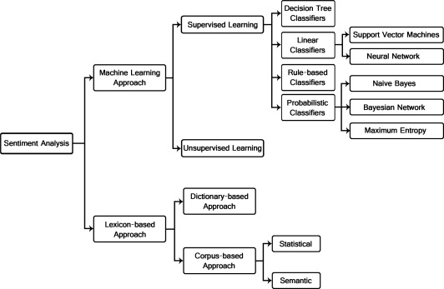
DIFFERENT METHODLOGIES TO IMPLEMENT SENTIMENT ANALYSIS

Slide 12
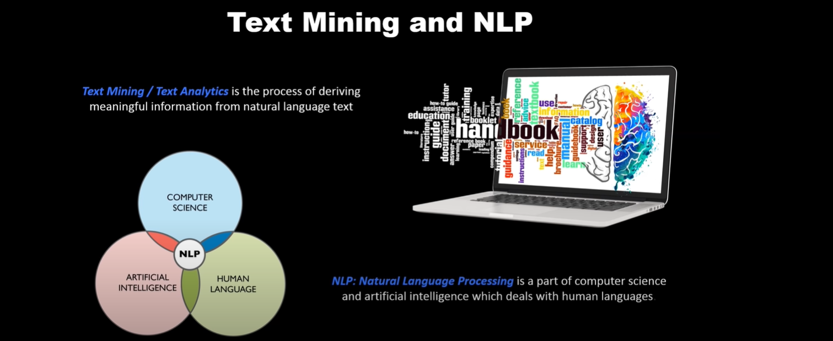
METHODOLOGY
What we had done till now is to understand one of most important methodology to implement sentiment analysis. And that methodology is Natural Language processing.

Slide 13
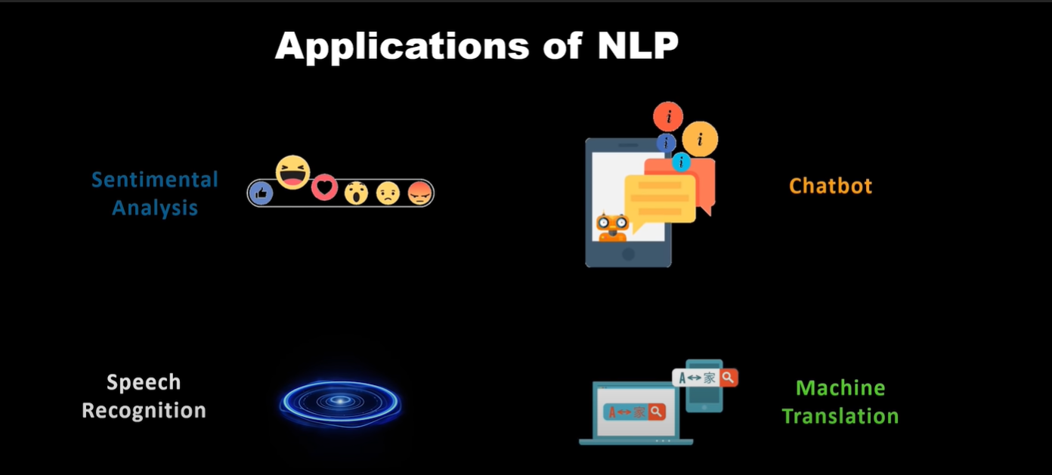
METHODOLOGY

Slide 14
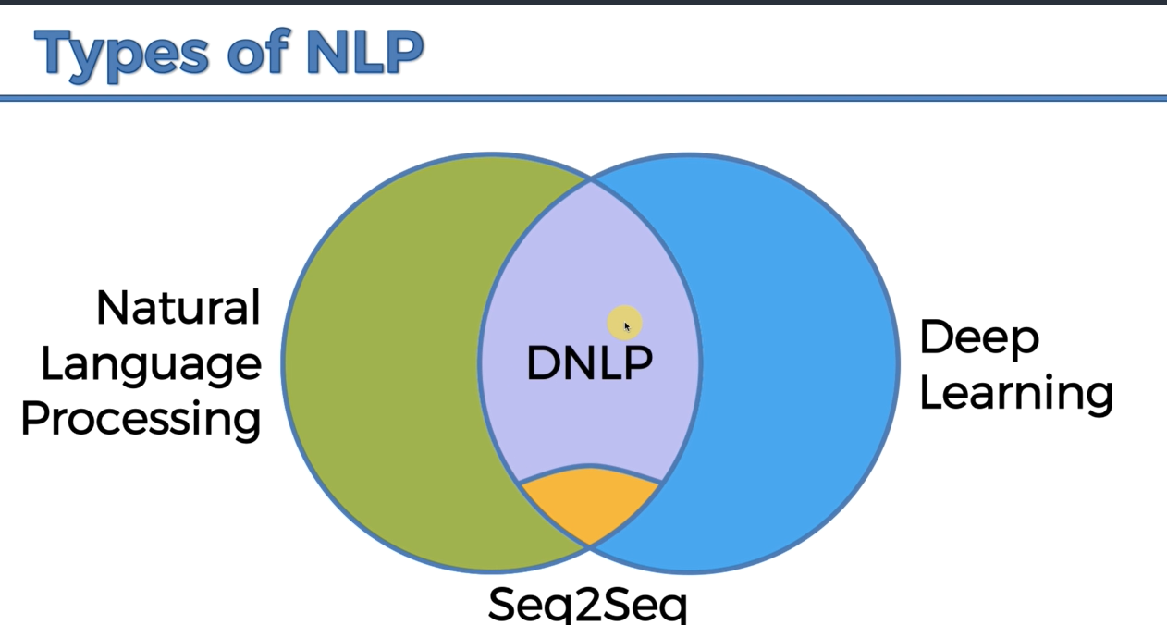
METHODOLOGY

Slide 15
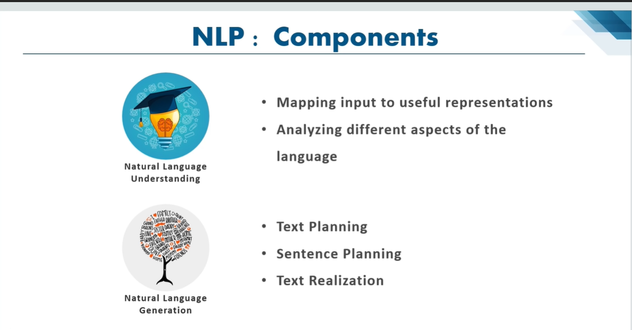
METHODOLOGY

Slide 16
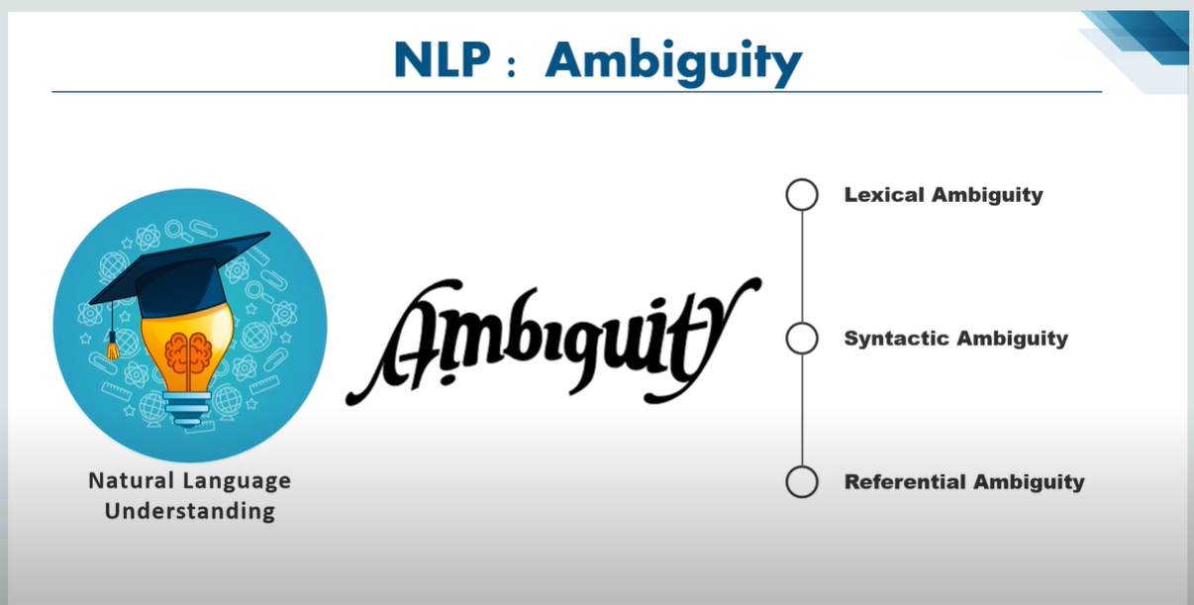
METHODOLOGY

Slide 17
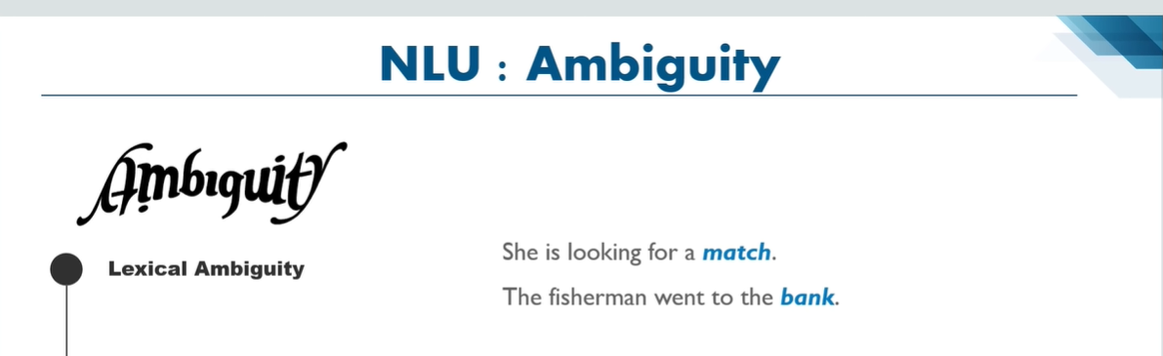
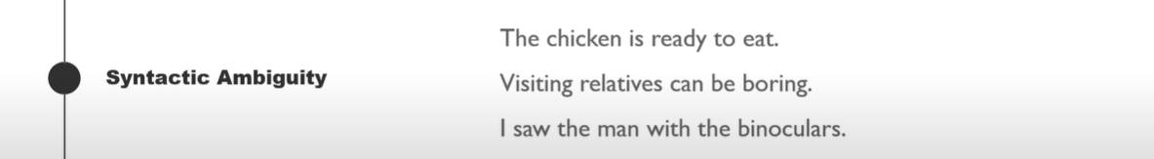
METHODOLOGY

Slide 18
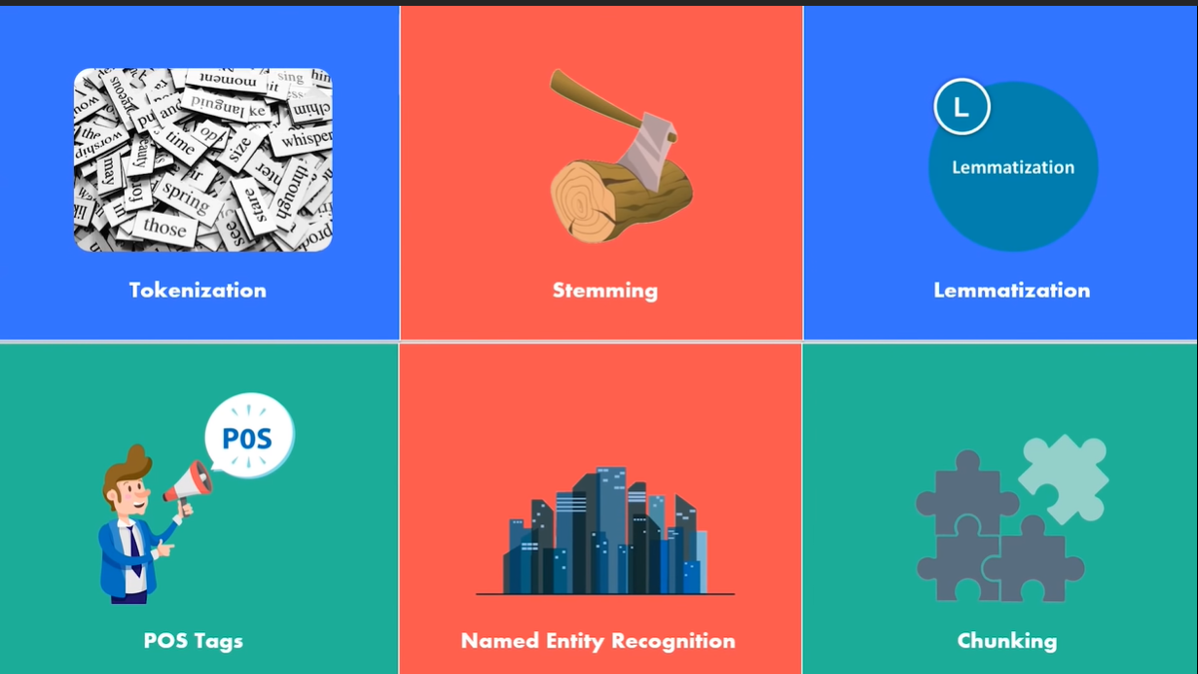
STEPS IN THE PROCESS OF IMPLEMENTING NLP

Slide 19
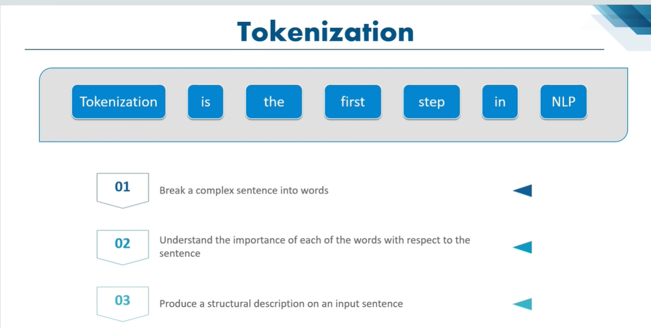
METHODOLOGY

Slide 20
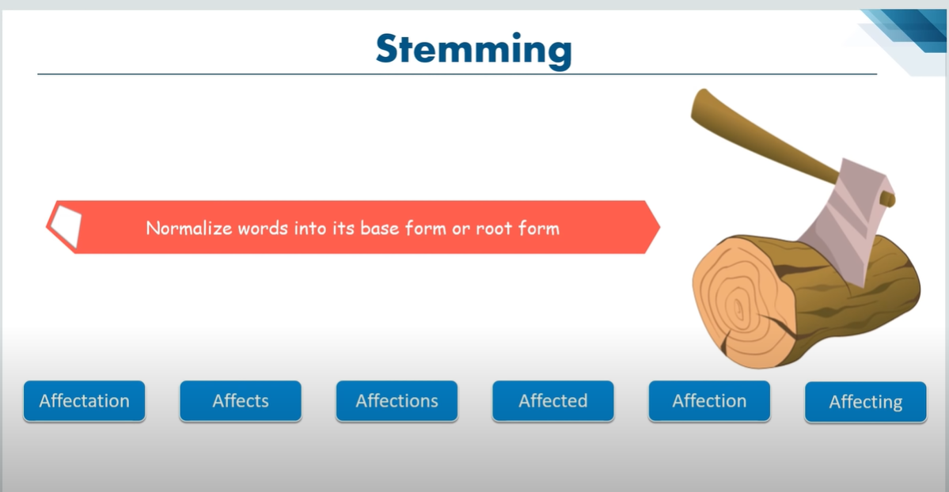

METHODOLOGY

Slide 21
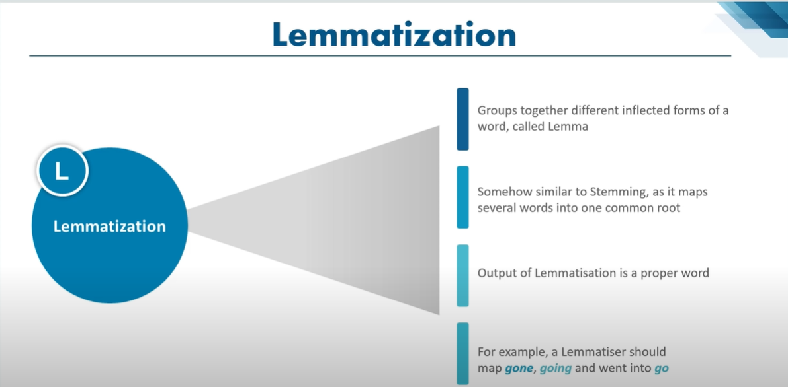
METHODOLOGY

Slide 22
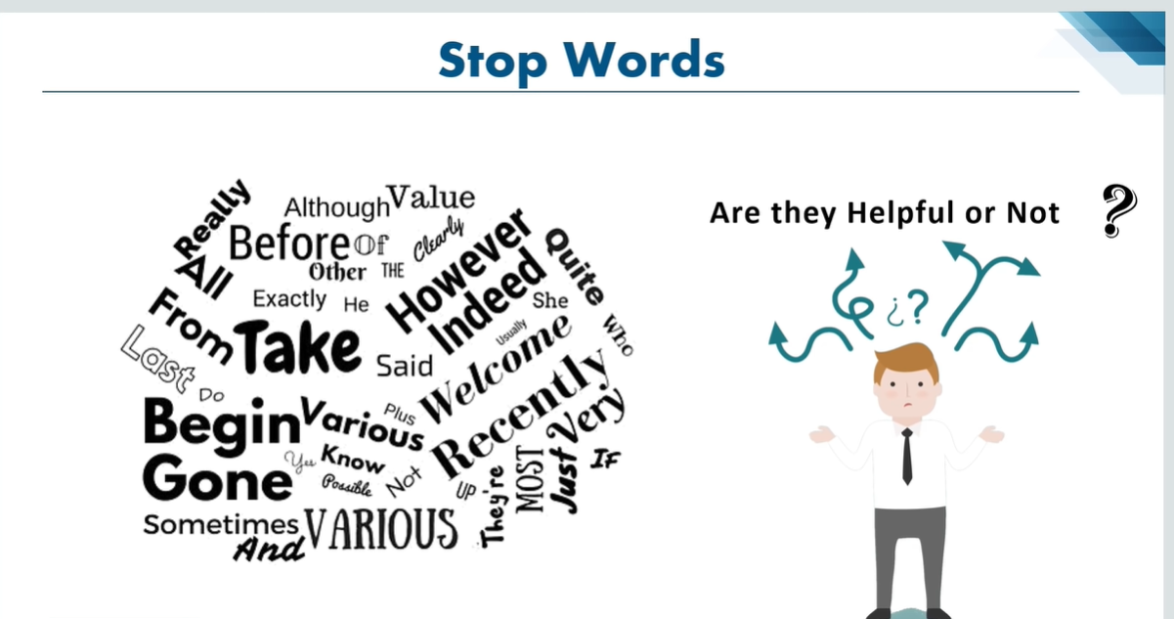
METHODOLOGY

Slide 23
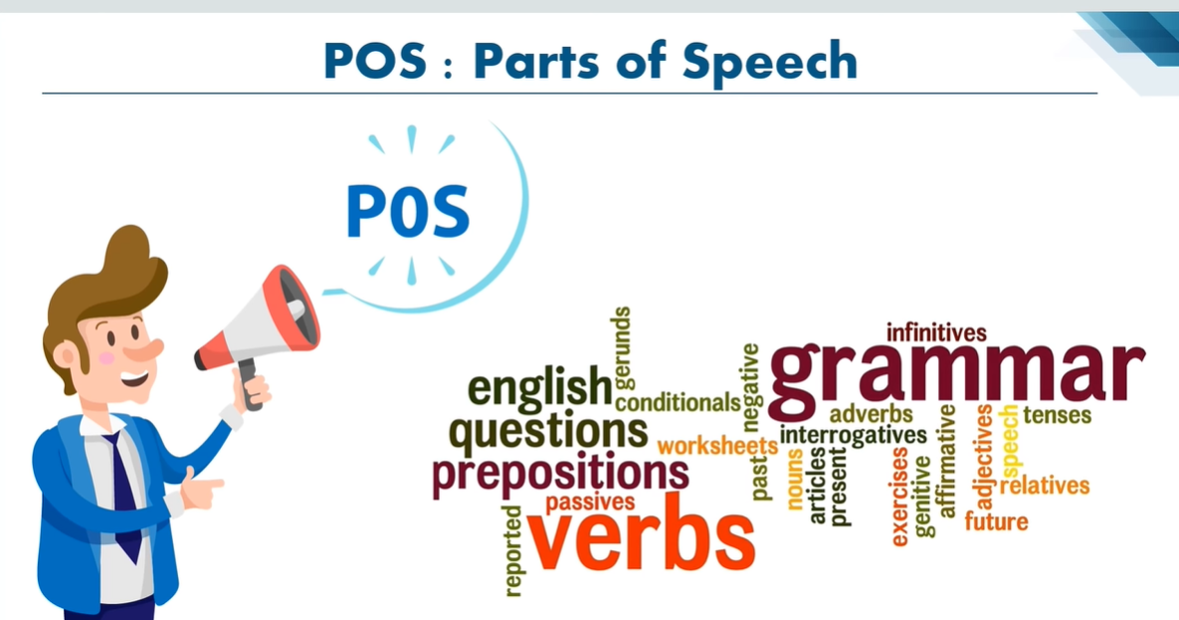
METHODOLOGY

Slide 24
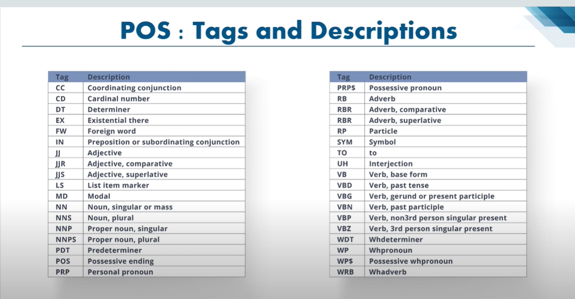
METHODOLOGY

Slide 25
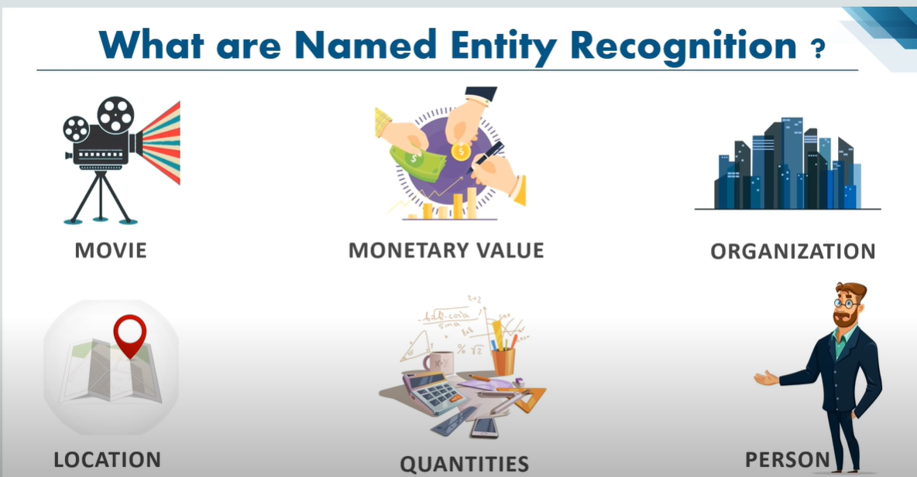
METHODOLOGY

Slide 26
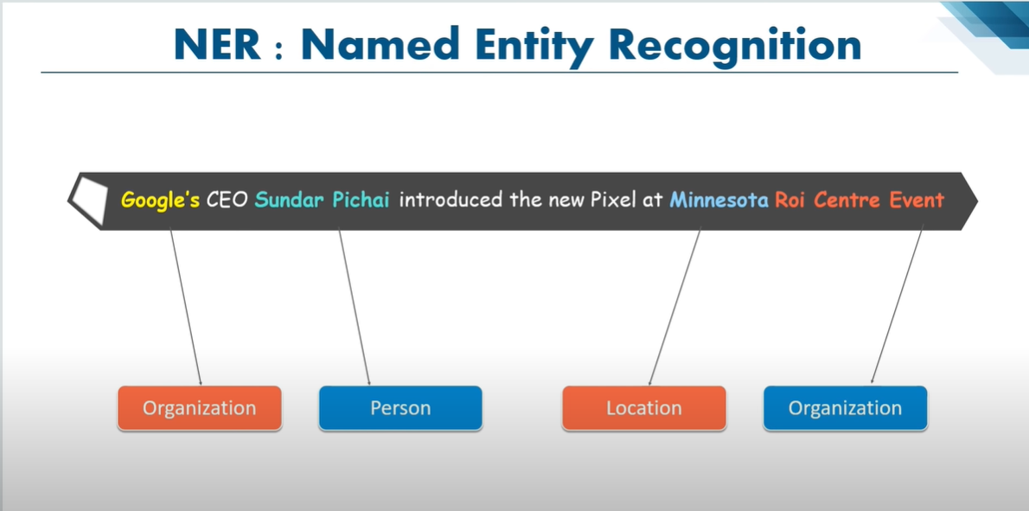
METHODOLOGY

Slide 27
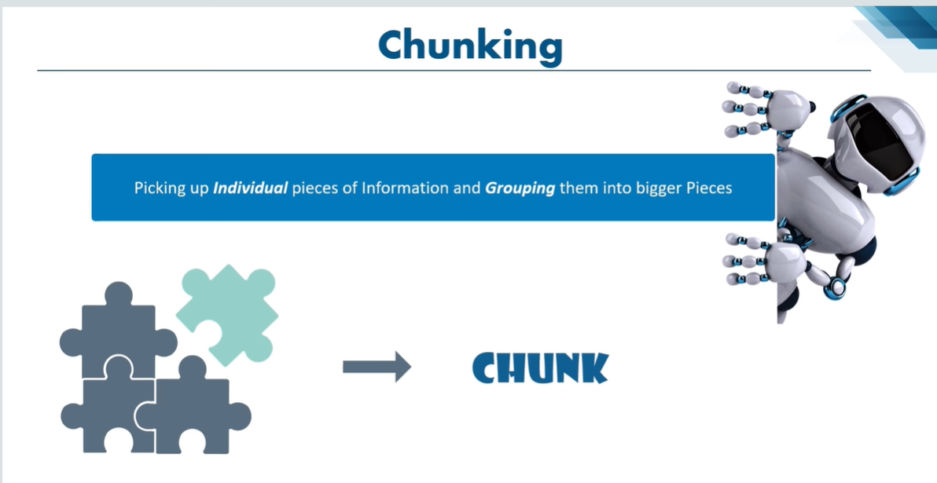
METHODOLOGY

Slide 28
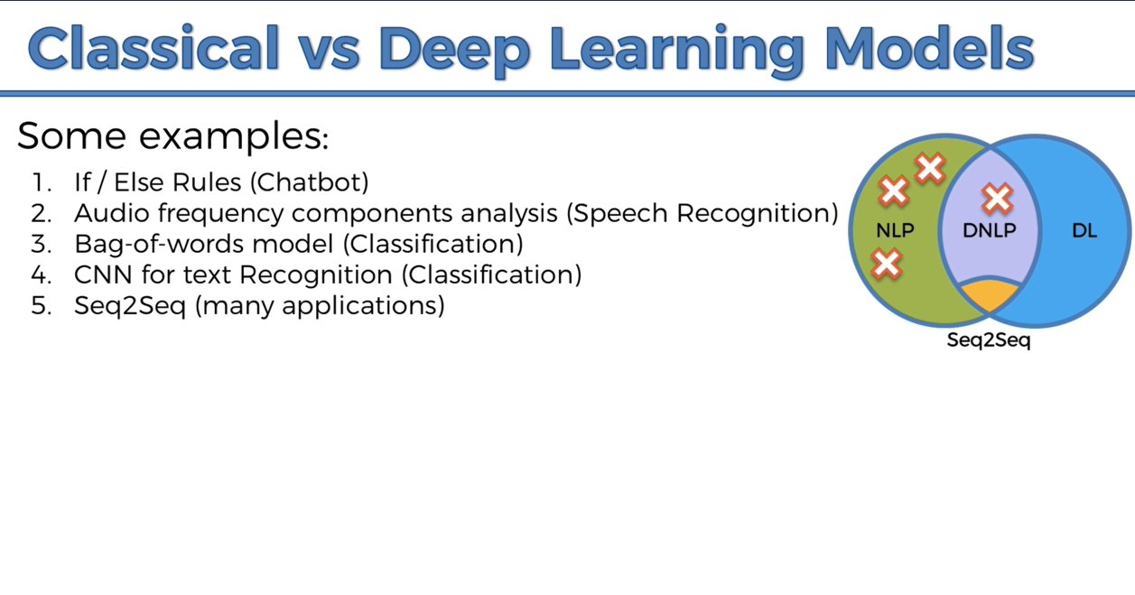
METHODOLOGY

Slide 29
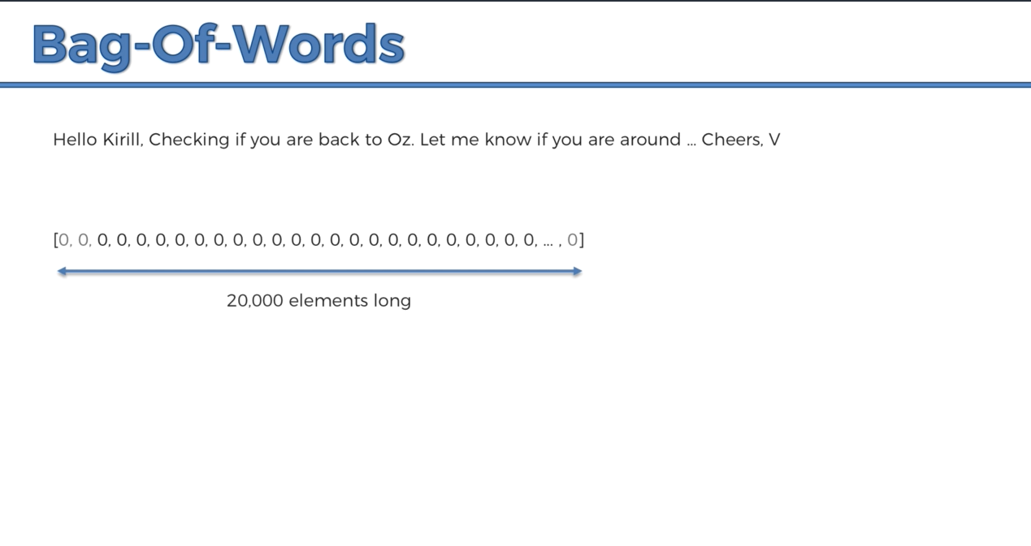
METHODOLOGY

Slide 30
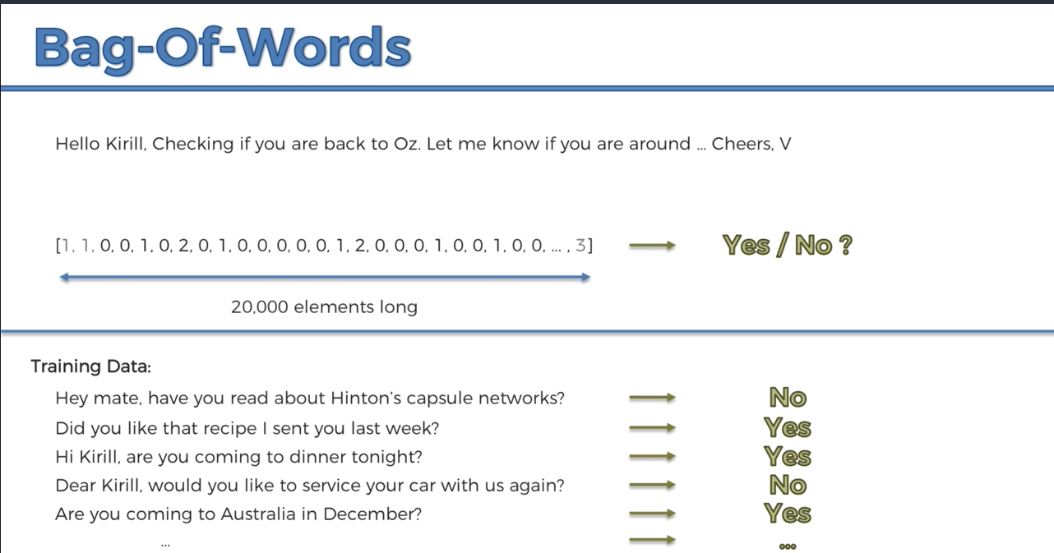
METHODOLOGY

Slide 31
METHODOLOGY
DIFFERENT STEPS IN IMPLEMENTING SENTIMENT ANALYSIS USING NLP
CONSIDERING THE EXAMPLE TO USE…….
THE MOVIE WAS GREAT…!!!
TOKENISATION
THE MOVIE WAS GREAT …..!

Slide 32
METHODOLOGY
2) CLEANING THE DATA
THE MOVIE WAS GREAT …..!
3) REMOVING STOP WORDS
THE MOVIE WAS GREAT
4)APPLY ANY ALGORITHM FOR CLASSIFICATION (PREFERABLY SUPERVISED ML ALGO )
MOVIE -> + / -
GREAT -> + / -

Slide 33
IMPLEMENTATION OF CODE

Slide 34
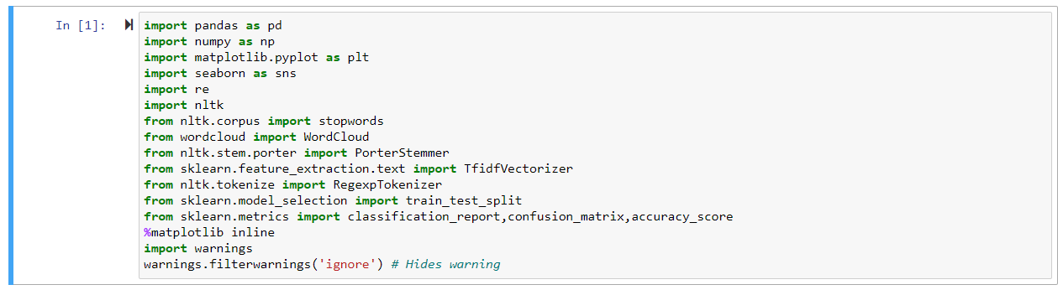
IMPORTING LIBRARIES AND DATA SET

Slide 35
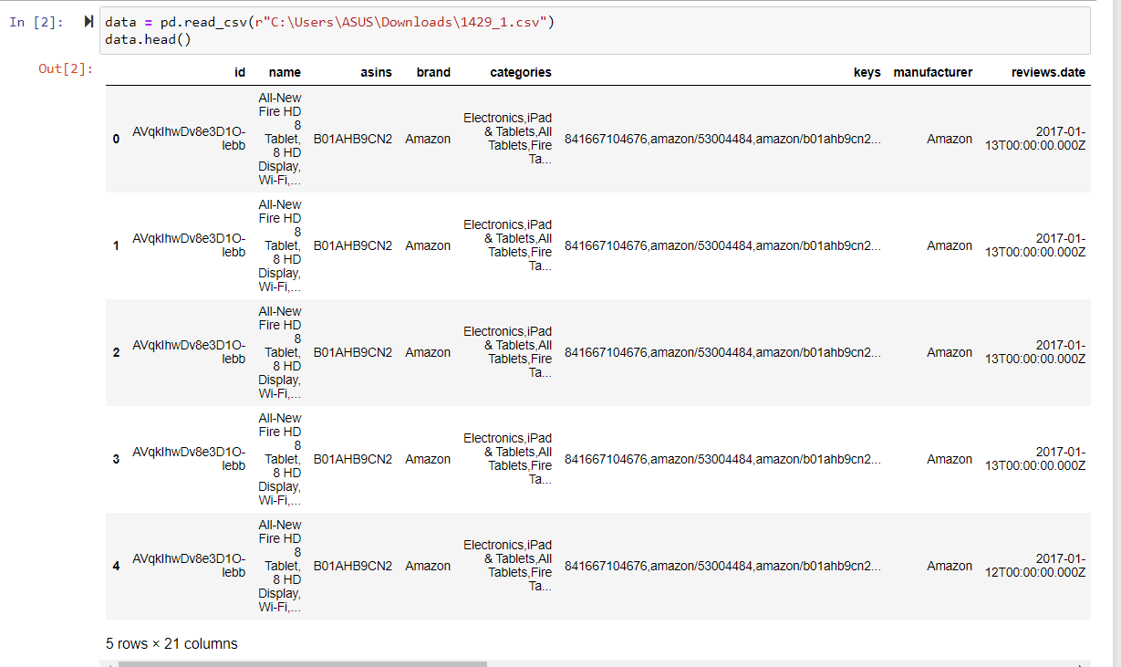
IMPORTING LIBRARIES AND DATA SET

Slide 36
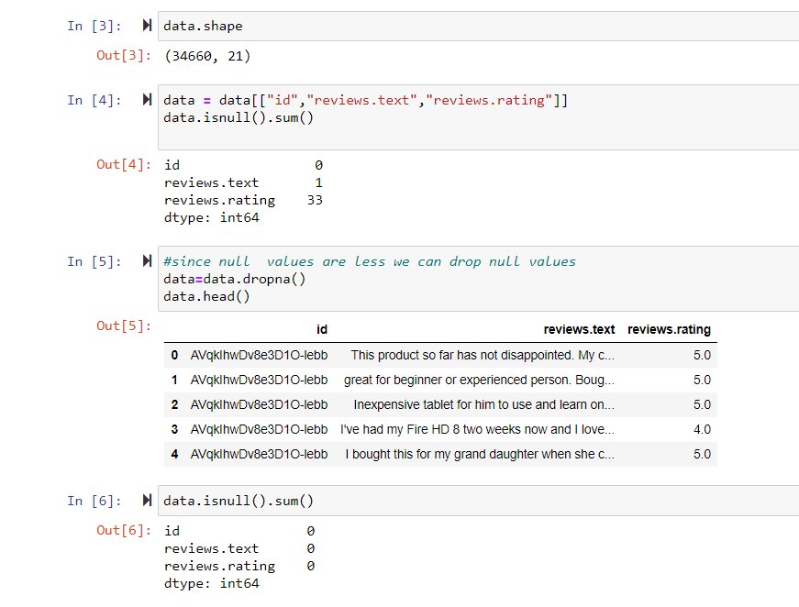
DATA STATISTICS

Slide 37
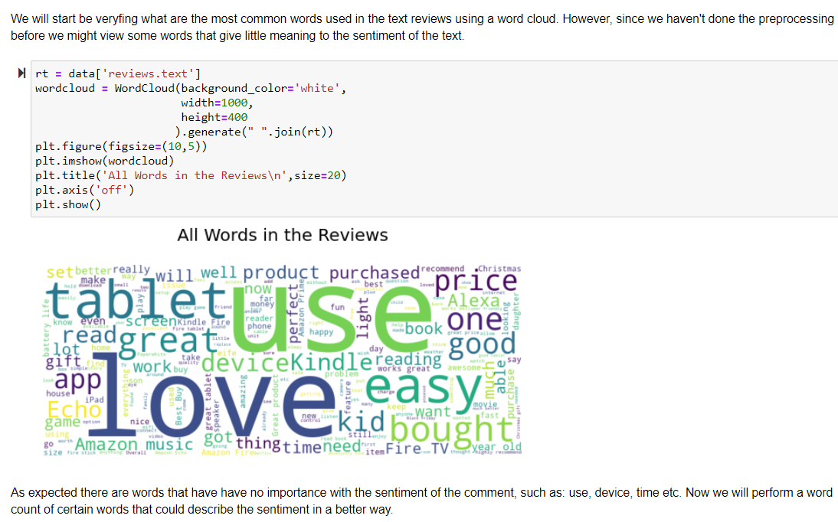
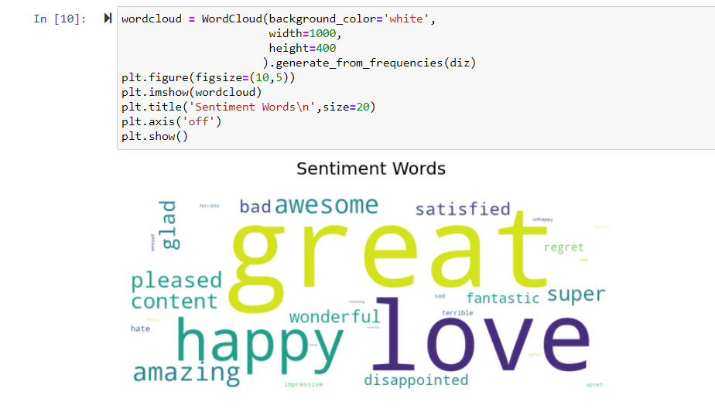
DATA ANALYSIS

Slide 38
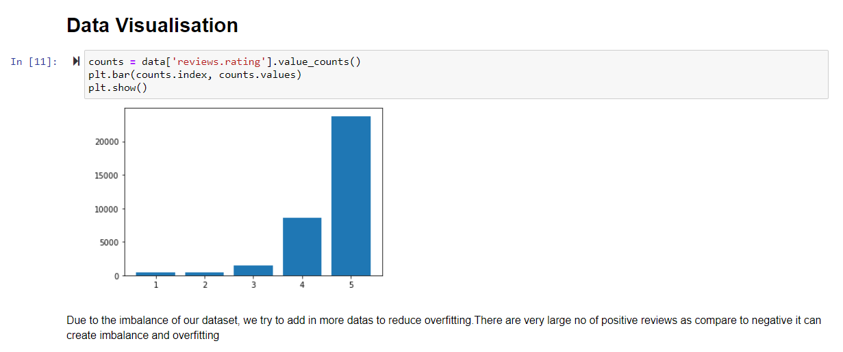
DATA VISUALISATION

Slide 39
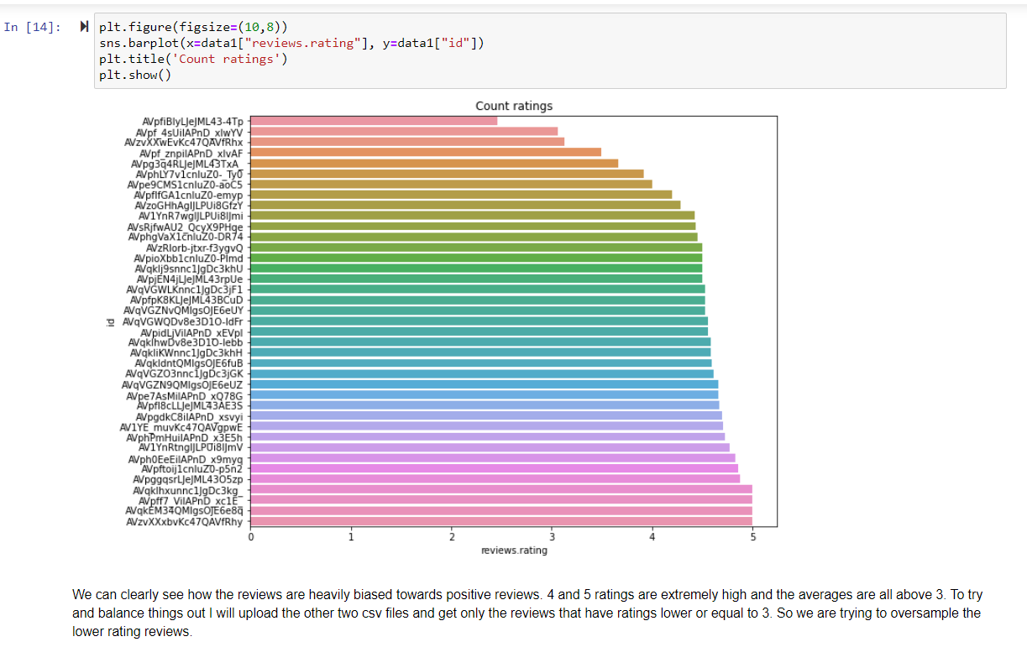
DATA VISUALISATION

Slide 40
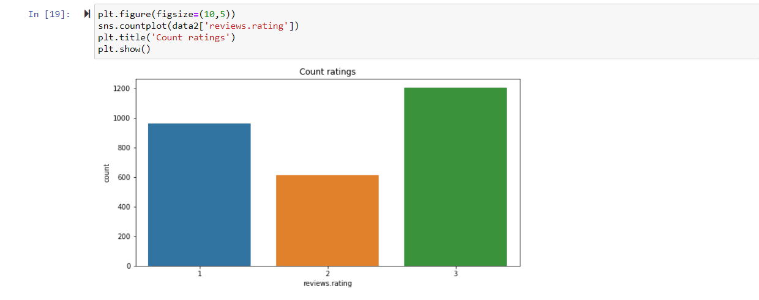
DATA VISUALISATION

Slide 41
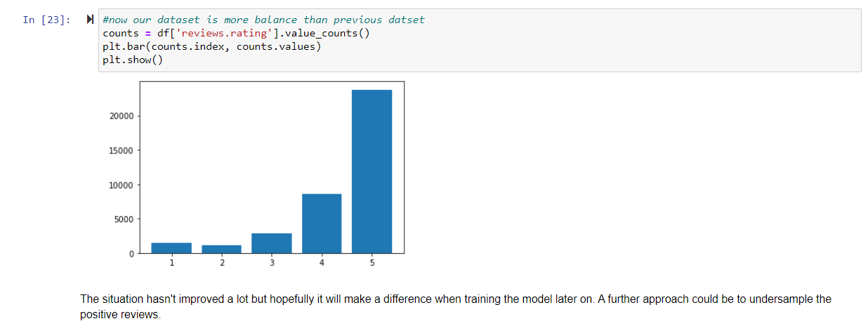
DATA VISUALISATION

Slide 42
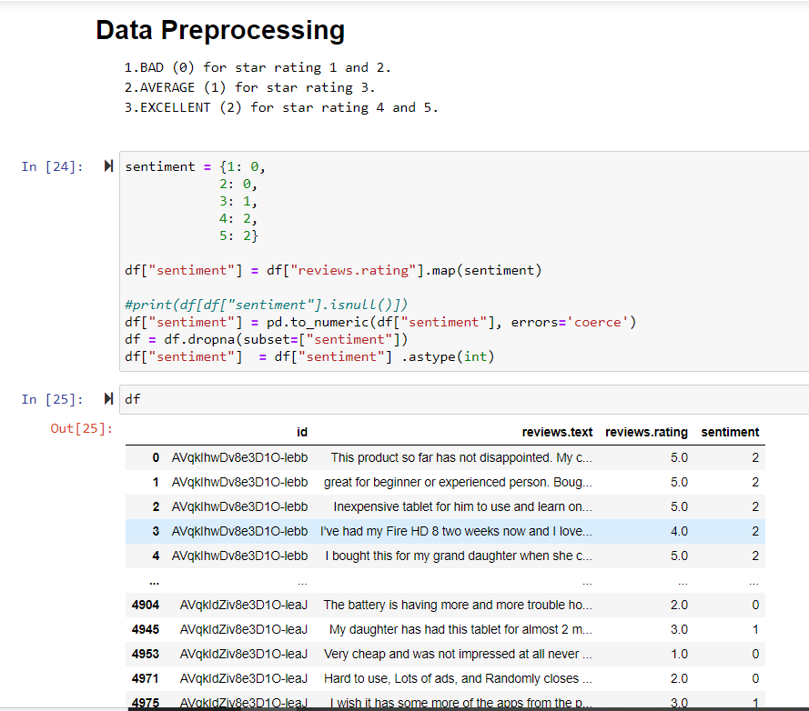
DATA PRE-PROCESSING
SCORE IS ASSIGNED TO EACH REVIEW RATING

Slide 43
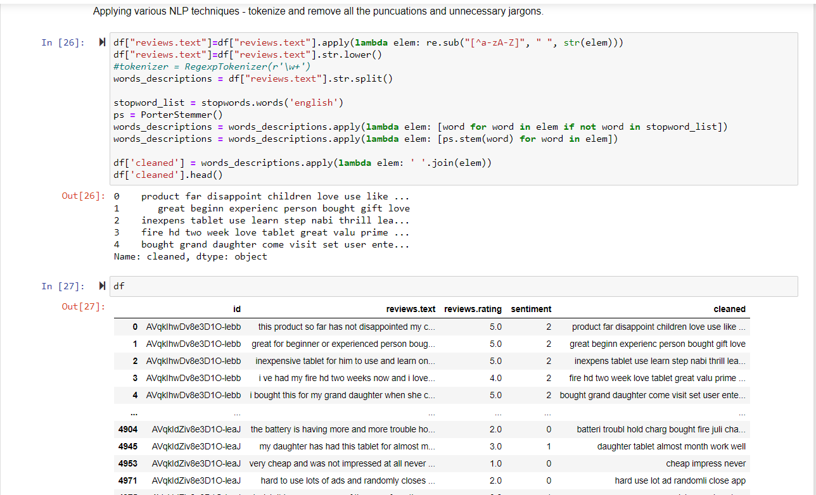
DATA PRE-PROCESSING
TOKENISATION

Slide 44
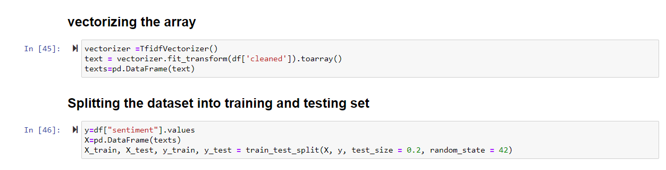
DATA PRE-PROCESSING
VECTORISATION

Slide 45
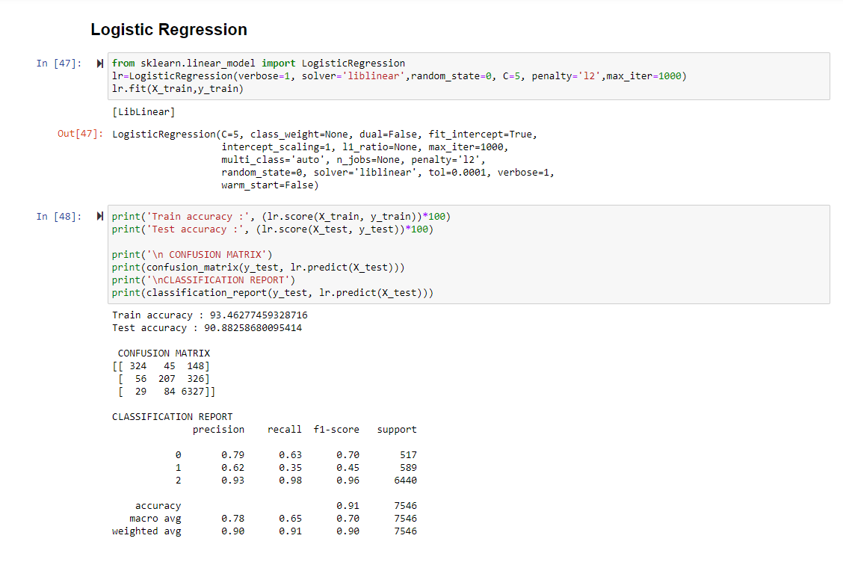
IMPLEMENTATION OF VARIOUS METHODLOGIES
LOGISTIC REGRESSION

Slide 46
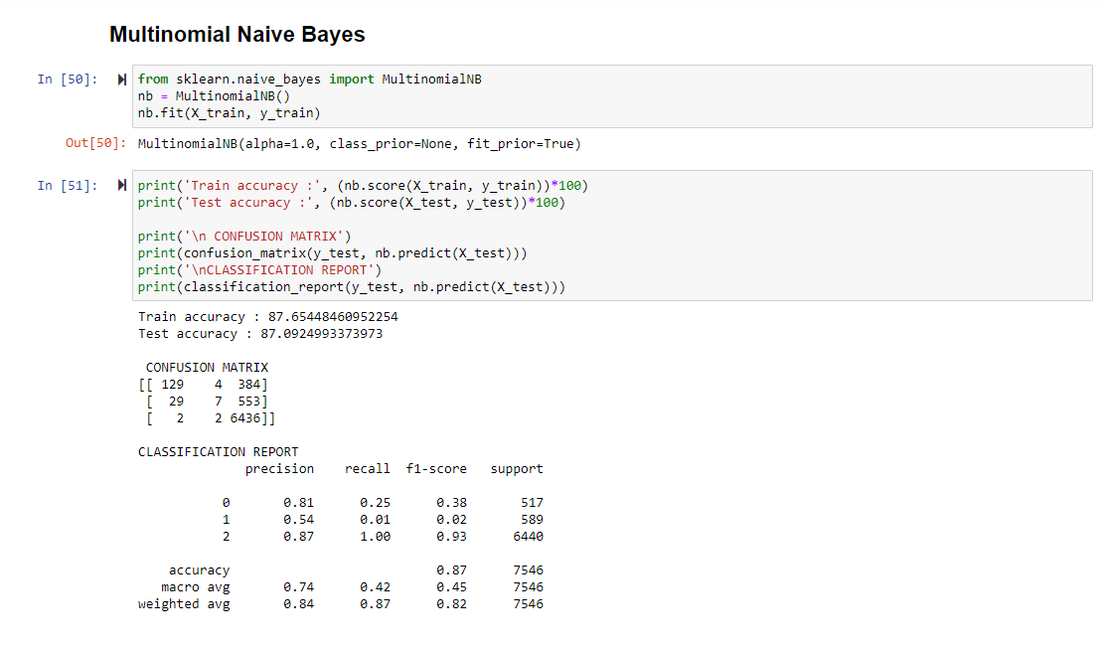
IMPLEMENTATION OF VARIOUS METHODLOGIES
NAÏVE BAYES

Slide 47
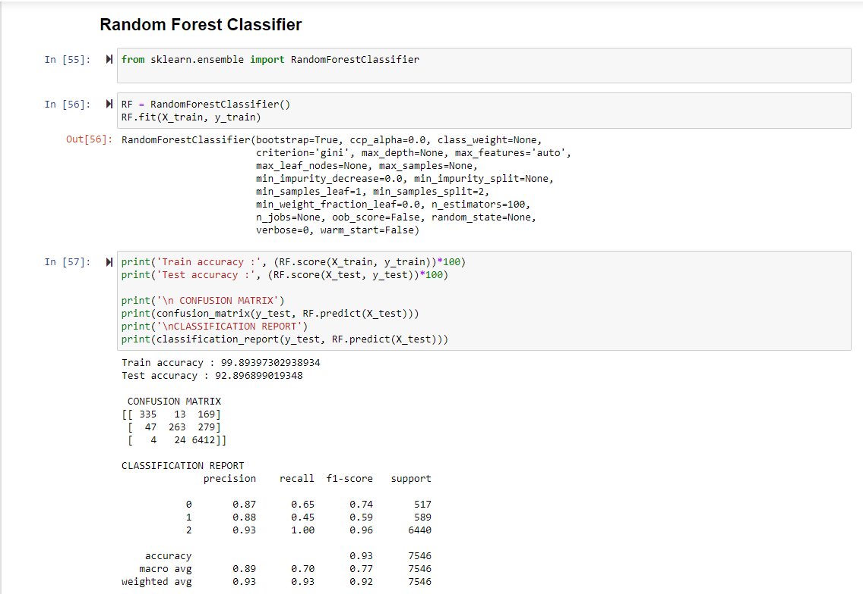
IMPLEMENTATION OF VARIOUS METHODLOGIES
RANDOM FOREST CLASSIFIER

Slide 48
RESULTS AND DISCUSSIONS
LINEAR
LINEAR
LINEAR

Slide 49
REFERENCES
[1] A Study on Sentiment Analysis of Product Reviews February 2018 DOI: 10.1109/ICSNS.2018.8573681 Conference: 2018 International Conference on Soft-computing and Network Security (ICSNS) Anil Singh Parihar, Bhagyanidhi.
[2] D. N. Devi, C. K. Kumar, and S. Prasad, “A feature based approach for sentiment analysis by using support vector machine,” in Advanced Computing (IACC), 2016 IEEE 6th International Conference on. IEEE, 2016, pp. 3–8.
[3] Dishi Jain, Bitra Harsha Vardhan, Saravanakumar Kandasamy, “Sentiment Analysis Of Product Reviews – A Survey”, INTERNATIONAL JOURNAL OF SCIENTIFIC & TECHNOLOGY RESEARCH VOLUME 8, ISSUE 12, DECEMBER 2019 ISSN 2277-8616.
[4] T. Wilson, J. Wiebe, and P. Hoffmann, “Recognizing contextual polarity in phrase-level sentiment analysis,” in Proceedings of the conference on human language technology and empirical methods in natural language processing. Association for Computational Linguistics, 2005, pp. 347–354.

Slide 50
THANK YOU….

